Slide 1
Handling Cookies
These slides have been modified for this course.
Originals of Slides and Source Code for Examples:
http://courses.coreservlets.com/Course-Materials/csajsp2.html

Slide 2
Sending Cookies to the Client
Create a Cookie object.
Call the Cookie constructor with a cookie name and a cookie value, both of which are strings.
Cookie c = new Cookie("userID", "a1234");
Set the maximum age.
To tell browser to store cookie on disk instead of just in memory, use setMaxAge (argument is in seconds)
c.setMaxAge(60*60*24*7); // One week
Place the Cookie into the HTTP response
Use response.addCookie.
If you forget this step, no cookie is sent to the browser!
response.addCookie(c);

Slide 3
Reading Cookies from the Client
Call request.getCookies()
This yields an array of Cookie objects.
Loop down the array, calling getName on each entry until you find the cookie of interest
Use the value (getValue) in application-specific way.
.
String cookieName = "userID";
Cookie[] cookies = request.getCookies();
if (cookies != null) {
for(Cookie cookie: cookies) {
if (cookieName.equals(cookie.getName())) {
doSomethingWith(cookie.getValue());
}
}
}

Slide 4
Using Cookies to Detect First-Time Visitors
@WebServlet("/repeat-visitor")
public class RepeatVisitor extends HttpServlet {
public void doGet(HttpServletRequest request, HttpServletResponse response)
throws ServletException, IOException {
boolean newbie = true;
Cookie[] cookies = request.getCookies();
if (cookies != null) {
for(Cookie c: cookies) {
if ((c.getName().equals("repeatVisitor")) &&
(c.getValue().equals("yes"))) {
newbie = false;
break;
}
}
}

Slide 5
Using Cookies to Detect First-Time Visitors (Continued)
String title;
if (newbie) {
Cookie returnVisitorCookie =
new Cookie("repeatVisitor", "yes");
returnVisitorCookie.setMaxAge(60*60*24*365);
response.addCookie(returnVisitorCookie);
title = "Welcome Aboard";
} else {
title = "Welcome Back";
}
response.setContentType("text/html");
PrintWriter out = response.getWriter();
… // (Output page with above title)

Slide 6
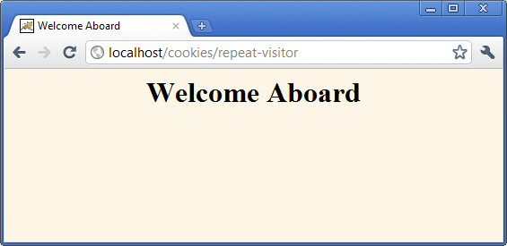
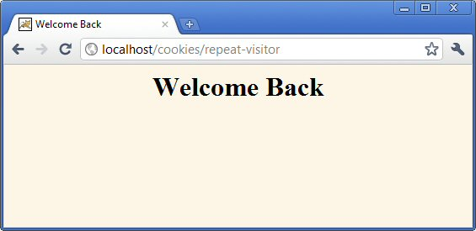
Using Cookies to Detect First-Time Visitors (Results)

Slide 7
Using Cookie Attributes
getMaxAge/setMaxAge
Gets/sets the cookie expiration time (seconds). If you fail to set, cookie applies to current browsing session only.
getName
Gets the cookie name. There is no setName method; you supply name to constructor. For incoming cookie array, you use getName to find the cookie of interest.
getValue/setValue
Gets/sets value associated with cookie. For new cookies, you supply value to constructor, not to setValue. For incoming cookie array, you use getName to find the cookie of interest, then call getValue on the result. If you set the value of an incoming cookie, you still have to send it back out with response.addCookie.

Slide 8
Differentiating Session Cookies from Persistent Cookies
@WebServlet("/cookie-test")
public class CookieTest extends HttpServlet {
public void doGet(HttpServletRequest request, HttpServletResponse response)
throws ServletException, IOException {
for(int i=0; i<3; i++) {
Cookie cookie =
new Cookie("Session-Cookie-" + i,
"Cookie-Value-S" + i);
// No maxAge (ie maxAge = -1)
response.addCookie(cookie);
cookie = new Cookie("Persistent-Cookie-" + i,
"Cookie-Value-P" + i);
cookie.setMaxAge(3600);
response.addCookie(cookie);
}

Slide 9
Differentiating Session Cookies from Persistent Cookies (Cont)
… // Start an HTML table
Cookie[] cookies = request.getCookies();
if (cookies == null) {
out.println("<tr><th COLSPAN=2>No cookies");
} else {
for(Cookie cookie: cookies) {
out.println
("<tr>\n" +
" <td>" + cookie.getName() + "\n" +
" <td>" + cookie.getValue());
}
}
out.println("</table></body></html>");
}
}

Slide 10
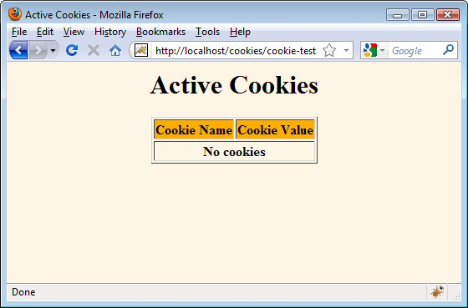
Differentiating Session Cookies from Persistent Cookies
Result of initial visit to CookieTest servlet
Same result as when visiting the servlet, quitting the browser, waiting an hour, and revisiting the servlet.

Slide 11
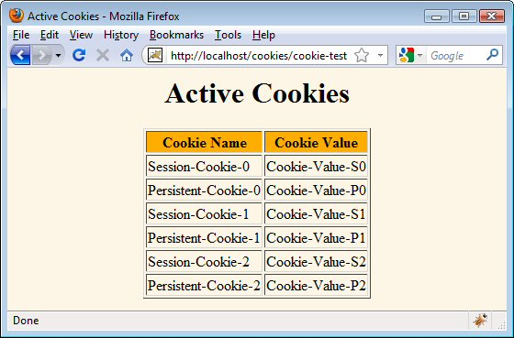
Differentiating Session Cookies from Persistent Cookies
Result of revisiting CookieTest within an hour of original visit (same browser session)
I.e., browser stayed open between the original visit and the visit shown here

Slide 12
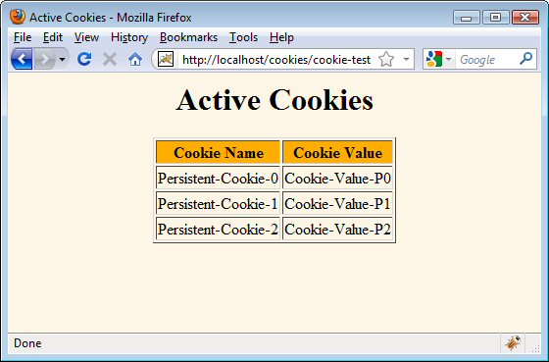
Differentiating Session Cookies from Persistent Cookies
Result of revisiting CookieTest within an hour of original visit (different browser session)
I.e., browser was restarted between the original visit and the visit shown here.

Slide 13
Utility: Finding Cookies with Specified Names
public class CookieUtilities {
public static String getCookieValue
(HttpServletRequest request,
String cookieName,
String defaultValue) {
Cookie[] cookies = request.getCookies();
if (cookies != null) {
for(Cookie cookie: cookies) {
if (cookieName.equals(cookie.getName())) {
return(cookie.getValue());
}
}
}
return(defaultValue);
}
…
}

Slide 14
Utility: Creating Long-Lived Cookies
public class LongLivedCookie extends Cookie {
public static final int SECONDS_PER_YEAR =
60*60*24*365;
public LongLivedCookie(String name, String value) {
super(name, value);
setMaxAge(SECONDS_PER_YEAR);
}
}

Slide 15
Modifying Cookie Values
Replacing a cookie value
Send the same cookie name with a different cookie value
Reusing incoming Cookie objects
Need to call response.addCookie; merely calling setValue is not sufficient.
Also need to reapply any relevant cookie attributes by calling setMaxAge, setPath, etc.—cookie attributes are not specified for incoming cookies.
Usually not worth the bother, so new Cookie object used
Instructing the browser to delete a cookie
Call setMaxAge(0)

Slide 16
Tracking User Access Counts
@WebServlet("/client-access-counts")
public class ClientAccessCounts extends HttpServlet {
public void doGet(HttpServletRequest request, HttpServletResponse response)
throws ServletException, IOException {
String countString =
CookieUtilities.getCookieValue(request,
"accessCount",
"1");
int count = 1;
try {
count = Integer.parseInt(countString);
} catch(NumberFormatException nfe) { }
LongLivedCookie c =
new LongLivedCookie("accessCount",
String.valueOf(count+1));
response.addCookie(c);

Slide 17
Tracking User Access Counts (Continued)
…
out.println(docType +
"<html>\n" +
"<head><title>" + title +
"</title></head>\n" +
"<body bgcolor=\"#FDF5E6\">\n" +
"<center>\n" +
"<h1>" + title + "</h1>\n" +
"<h2>This is visit number " +
count + " by this browser.</h2>\n"+
"</center></body></html>");
}
}

Slide 18
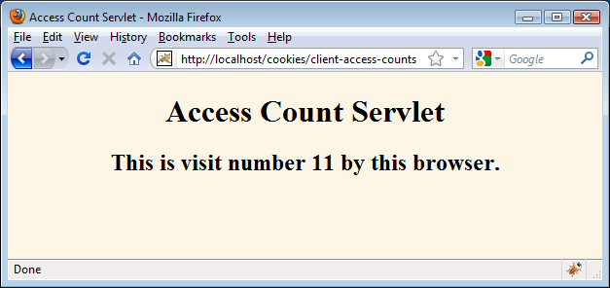
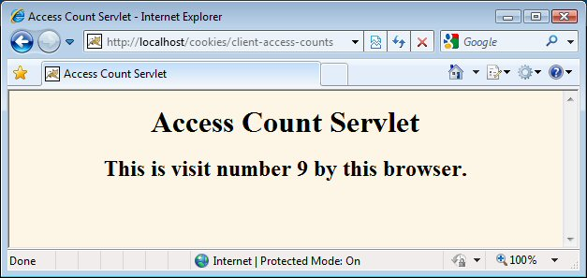
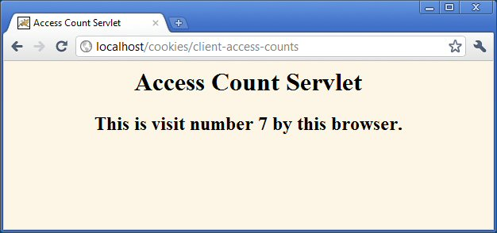
Tracking User Access Counts (Results)

Slide 19
Using Cookies to Remember User Preferences
RegistrationForm servlet
Uses cookie values to prepopulate form field values
Uses default values if no cookies are found
Will be redone in JSP later in class
Registration servlet
Creates cookies based on request parameters received
Displays values if all parameters are present
Redirects to form if any parameter is missing

Slide 20
RegistrationForm Servlet
@WebServlet("/registration-form")
public class RegistrationForm extends HttpServlet {
public void doGet(HttpServletRequest request, HttpServletResponse response)
throws ServletException, IOException {
response.setContentType("text/html");
PrintWriter out = response.getWriter();
String firstName =
CookieUtilities.getCookieValue(request,
"firstName", "");
String lastName =
CookieUtilities.getCookieValue(request,
"lastName", "");
String emailAddress =
CookieUtilities.getCookieValue(request,
"emailAddress",
"");

Slide 21
RegistrationForm Servlet (Continued)
out.println
(docType +
"<html>\n" +
"<head><title>" + title + "</title ></head >\n" +
"<body bgcolor=\"#FDF5E6\">\n" +
"<center>\n" +
"<h1>" + title + "</h1>\n" +
"<form action=\"registration\">\n" +
"First Name:\n" +
" <input type=\"text\" name=\"firstName\" " +
"VALUE=\"" + firstName + "\"><br>\n" +
"Last Name:\n" +
" <input type=\"text\" name=\"lastName\" " +
"VALUE=\"" + lastName + "\"><br>\n"+
"Email Address: \n" +
" <input type=\"text\" name=\"emailAddress\" " +
"VALUE=\"" + emailAddress + "\"><p>\n" +
"<input type=\"submit\" value=\"Register\">\n" +
"</form></center></body></html>");
}
}

Slide 22
Registration Servlet
@WebServlet("/registration")
public class RegistrationServlet extends HttpServlet {
public void doGet(HttpServletRequest request,
HttpServletResponse response)
throws ServletException, IOException {
response.setContentType("text/html");
boolean isMissingValue = false;
String firstName =
request.getParameter("firstName");
if (CookieUtilities.isNullOrEmpty(firstName)) {
firstName = "Missing first name";
isMissingValue = true;
}
String lastName =
request.getParameter("lastName");
if (CookieUtilities.isNullOrEmpty(lastName)) {
lastName = "Missing last name";
isMissingValue = true;
}
…

Slide 23
Registration Servlet (Continued)
Cookie c1 =
new LongLivedCookie("firstName", firstName);
response.addCookie(c1);
Cookie c2 =
new LongLivedCookie("lastName", lastName);
response.addCookie(c2);
Cookie c3 = new LongLivedCookie("emailAddress",
emailAddress);
response.addCookie(c3);
if (isMissingValue) {
response.sendRedirect("registration-form");
} else { … }

Slide 24
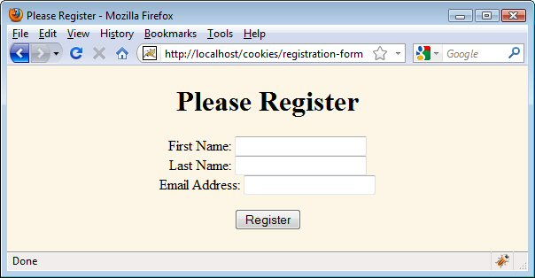
RegistrationForm (Initial Result)

Slide 25
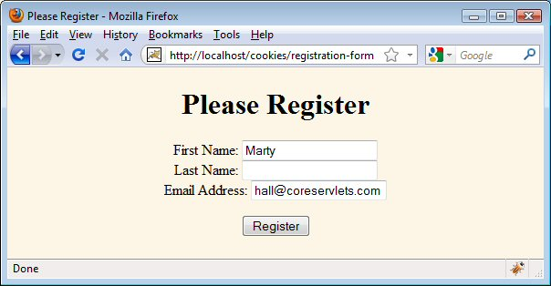
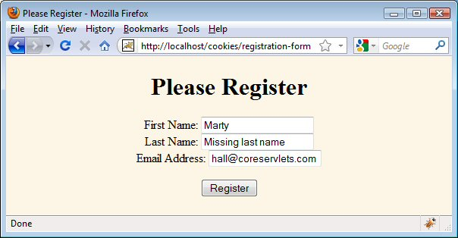
RegistrationForm (Submitting Incomplete Form)

Slide 26
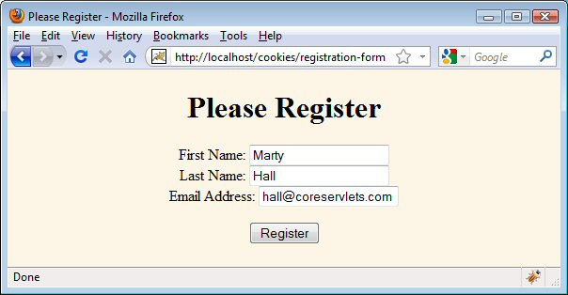
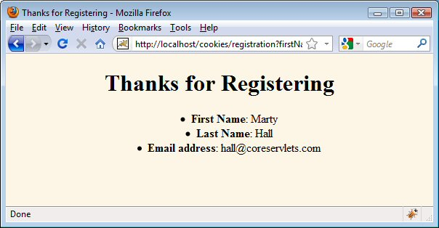
RegistrationForm (Submitting Complete Form)

